Slide 1

CO1 ASSESSMENT TOOL – 03
TECHNICAL PRESENTATION
CSA0509 – Database Management System
PRESENTED BY :
KADHIREZHILAN. D(192511228)
GUIDED BY:
Dr. R. KESAVAN

Slide 2


TOPIC 1 – ER Diagram for Online Library System
Introduction to ER Diagram
An Entity Relationship (ER) Diagram is a graphical representation of the database structure and the relationships between data.
It identifies entities, attributes, and relationships, providing a clear blueprint for database design.
ER diagrams help developers organize data efficiently and reduce duplication or inconsistency.
They improve communication between database designers, developers, and end users during system development.
In an Online Library System, an ER diagram manages books, members, librarians, loans, and their relationships.

Slide 3
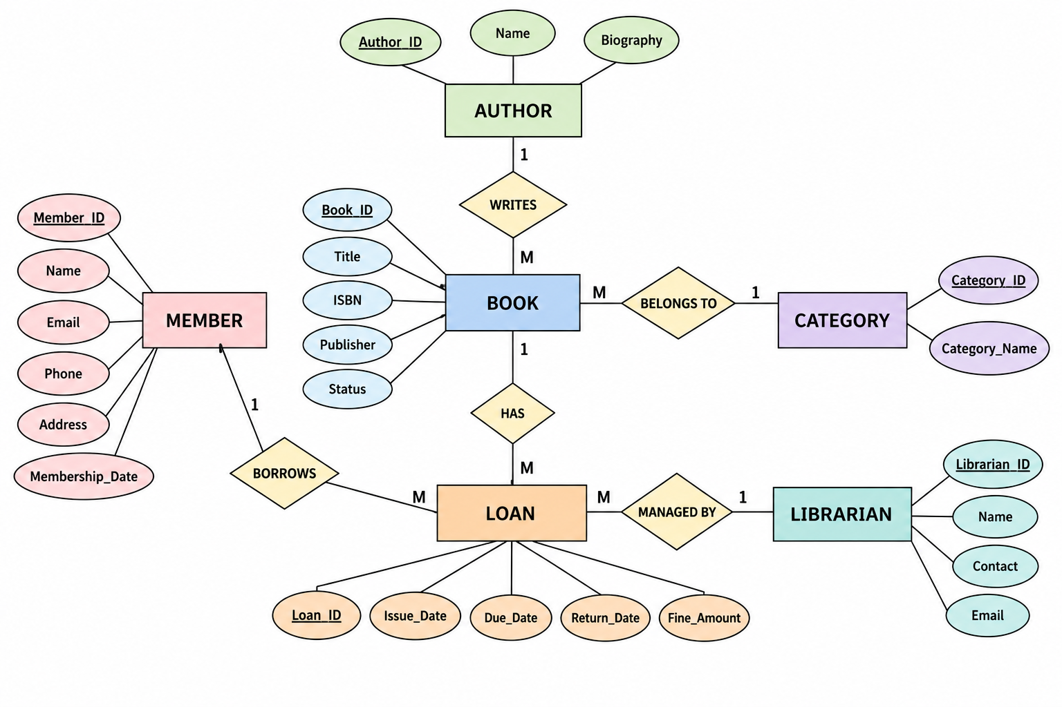
ER Diagram for Online Library System

Slide 4
Components of an Online Library ER Diagram
Entities: The main objects in the system include Book, Member, Librarian, Loan, Author, and Category, each representing important information stored in the database.
Attributes: Every entity contains descriptive properties such as Book_ID, Title, ISBN, Member_ID, Name, Issue Date, and Return Date, which provide detailed information.
Primary Keys: Each entity has a unique identifier (e.g., Book_ID, Member_ID, Loan_ID) that uniquely distinguishes every record in the database.
Relationships: Entities are connected through relationships such as Member borrows Book, Librarian issues Loan, Book belongs to Category, and Author writes Book.
Cardinality: Relationships define how entities interact, such as One Member can borrow many Books, One Category contains many Books, and One Book can have multiple Loan records over time.

Slide 5
Advantages and Conclusion
Advantages
Improves Database Design: Provides a clear and structured blueprint for designing an efficient database.
Reduces Data Redundancy: Organizes data properly, minimizing duplicate records and maintaining consistency.
Simplifies Maintenance: Makes it easier to update, modify, and expand the database as requirements change.
Enhances Data Integrity: Defines relationships clearly, ensuring accurate and reliable data management.
Conclusion
The ER Diagram is a fundamental tool used for designing well-structured databases.
It clearly represents entities, attributes, and relationships in a simple visual format.
ER modeling helps developers build databases that are efficient, scalable, and easy to maintain.
An Online Library System designed using an ER diagram ensures better organization, faster data retrieval, and reliable management of books and members.

Slide 6
Topic 02 - EER Model: Generalization & Specialization ( University Case Study )
The Enhanced Entity Relationship (EER) Model is an extension of the traditional ER model used in database design.
It introduces advanced concepts such as Generalization, Specialization, Inheritance, and Categorization.
EER models represent complex real-world applications more accurately than basic ER diagrams.
It improves database flexibility, scalability, and reduces data redundancy.
EER is widely used in large systems such as universities, hospitals, banks, and enterprise applications.

Slide 7
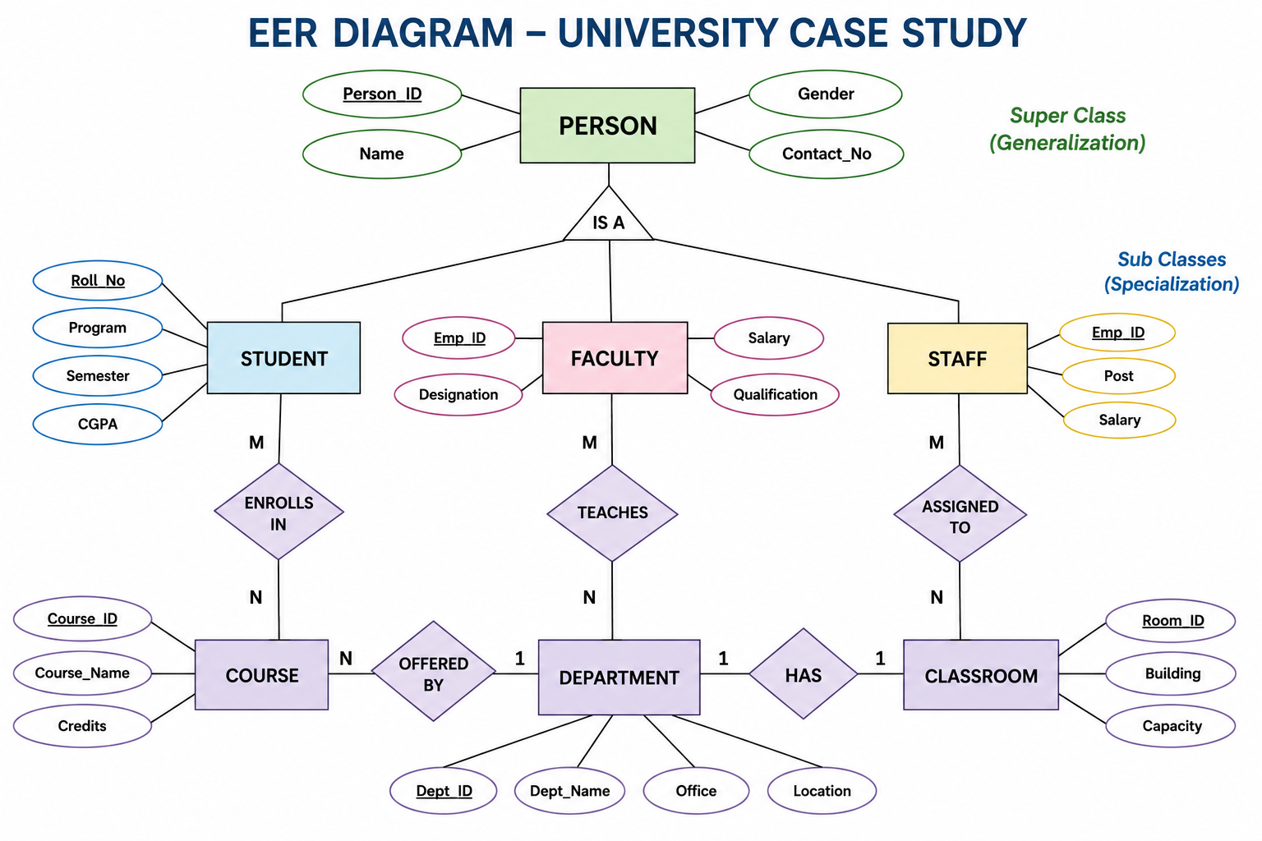
EER Diagram for University

Slide 8
Components of University EER Model
Superclass: The Person entity stores common attributes such as Person_ID, Name, Gender, and Contact Number.
Specialization: The Person entity is divided into Student, Faculty, and Staff, each having its own specific attributes.
Generalization: Student, Faculty, and Staff share common characteristics and are generalized into the Person entity.
Relationships: Student enrolls in Course, Faculty teaches Course, and Department offers multiple Courses.
Benefits: The EER model reduces redundancy, improves data organization, and simplifies database maintenance.

Slide 9
Advantages and Conclusion
Advantages
Represents complex real-world systems more accurately than the basic ER model.
Supports inheritance through Generalization and Specialization concepts.
Reduces data redundancy by storing common attributes in a superclass.
Makes large database systems easier to design, manage, and maintain.
Conclusion
The EER Model enhances the traditional ER model by supporting advanced database concepts.
It provides a clear representation of hierarchical relationships between entities.
The University case study demonstrates how EER simplifies the management of students, faculty, and departments.
EER modeling helps create scalable, flexible, and efficient database systems for real-world applications.

Slide 10
Topic 03 - Data Independence in DBMS
Introduction
Data Independence is the ability to modify the database schema without affecting application programs.
It is one of the most important features of a Database Management System (DBMS).
It separates the physical storage of data from the way users access the data. Data independence improves database flexibility, scalability, and maintainability.
There are two types of Data Independence:
Physical Data Independence
Logical Data Independence

Slide 11
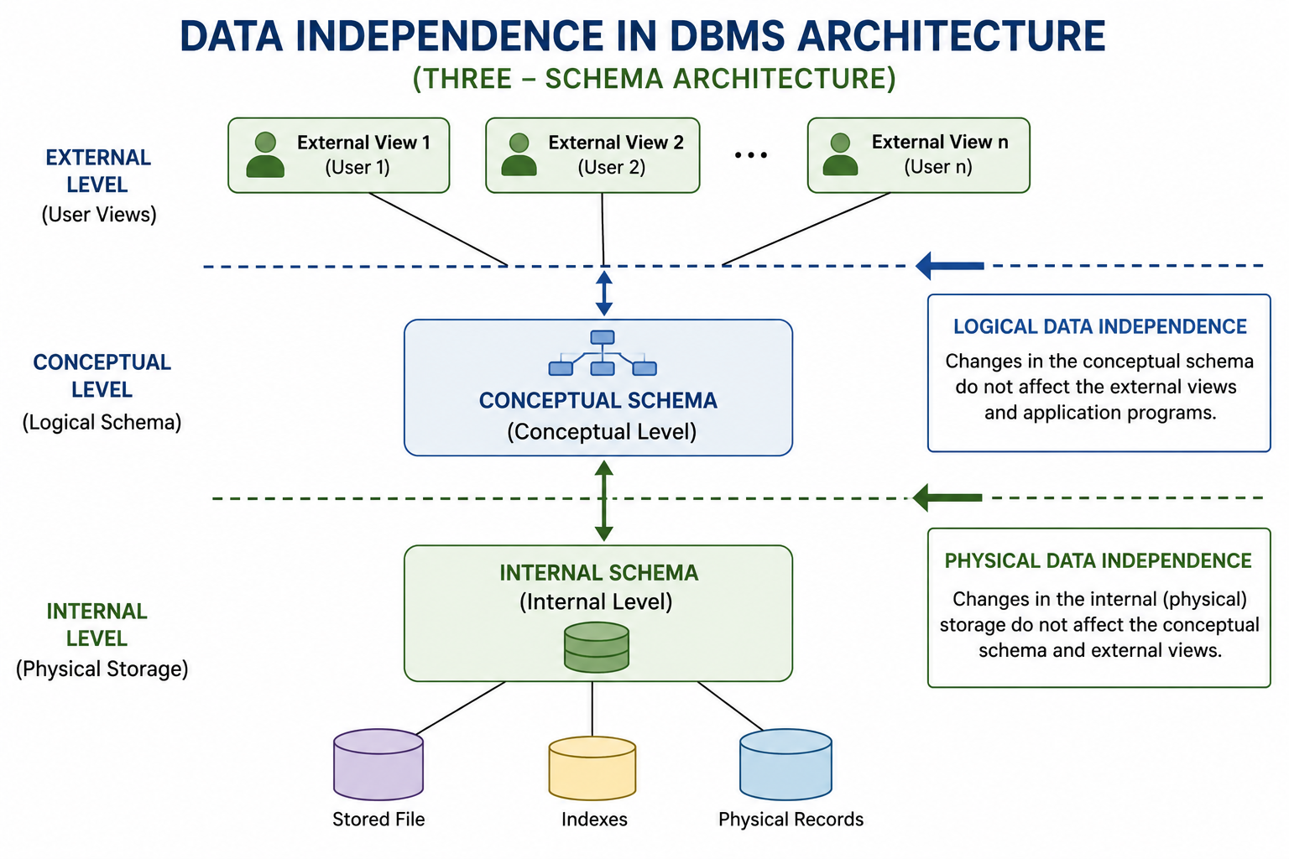
Data Independence in DBMS Architecture

Slide 12
Physical vs Logical Data Independence
Physical Data Independence | Logical Data Independence
Changes physical storage. | Changes logical schema.
Does not affect conceptual schema. | Does not affect external views.
Examples: Indexing, file organization, storage devices. | Examples: Adding attributes, tables, relationships.
Easier to achieve. | More difficult to achieve.

Slide 13
Importance of Data Independence
Improves Flexibility: Allows database modifications without changing application programs.
Reduces Maintenance Cost: Changes in the database require minimal updates to existing software.
Enhances Performance: Physical storage can be optimized without affecting users.
Supports Database Growth: New tables and attributes can be added as requirements change.
Ensures Long-Term Reliability: Makes the database scalable, consistent, and easier to maintain.
Conclusion
Data Independence is a fundamental feature of DBMS architecture that separates user applications from database changes, ensuring flexibility, efficient maintenance, and long-term system reliability.

Slide 14
Topic 04 - DBMS Software Components
A Database Management System (DBMS) consists of software components that manage data efficiently.
These components work together to process queries, store data securely, and maintain database consistency.
They improve database performance, security, and reliability.
The three major software components are Query Processor, Storage Manager, and Transaction Manager.
Each component performs a specific function to ensure smooth database operations.

Slide 15
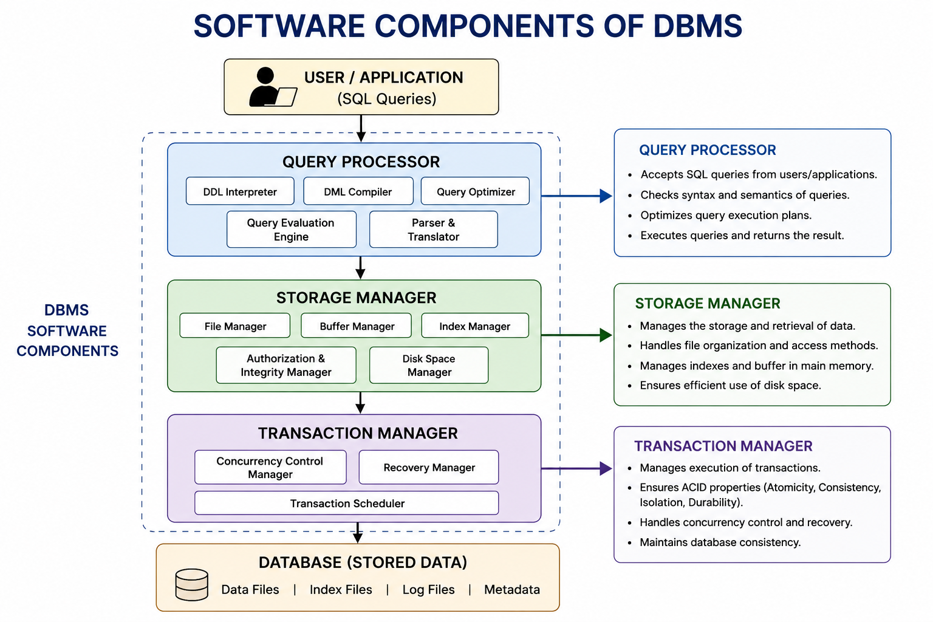
DBMS Software Components Diagram

Slide 16
Functions of Software Components
Query Processor: Accepts SQL queries, checks syntax, optimizes execution, and retrieves the required data efficiently.
Storage Manager: Manages physical storage, file organization, indexes, buffers, and efficient data retrieval.
Transaction Manager: Controls database transactions, maintains consistency, and handles concurrency and recovery.
Together, these components ensure fast, secure, and reliable database operations.
They support efficient data access while maintaining accuracy and integrity.

Slide 17
Advantages and Conclusion
Advantages
Improves query processing speed and database performance.
Ensures secure and organized storage of database files.
Maintains data consistency through transaction management.
Supports reliable recovery from system failures and concurrent access.
Conclusion
The Query Processor, Storage Manager, and Transaction Manager are the core software components of a DBMS.
They work together to provide efficient data processing, secure storage, and reliable transaction handling.
These components ensure the database remains accurate, consistent, and available to users.
A well-designed DBMS improves overall system performance and simplifies database management.

Slide 18
Topic 05 - Strong & Weak Entities
Introduction:
An Entity represents a real-world object that stores information in a database.
ER modeling classifies entities into Strong Entities and Weak Entities.
A Strong Entity can exist independently and has its own Primary Key.
A Weak Entity depends on a Strong Entity for its existence.
Understanding both entity types helps create accurate and efficient database designs.

Slide 19
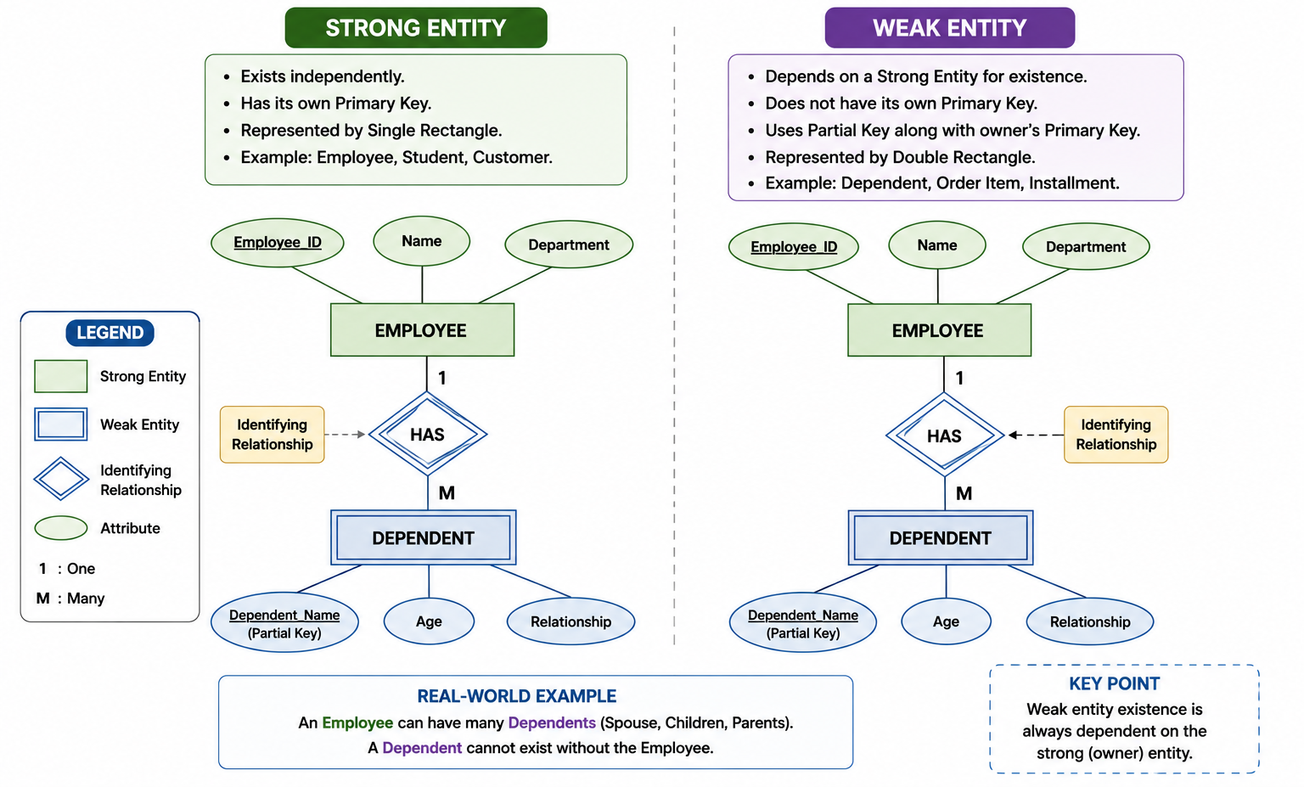
Strong and Weak Entity Diagram

Slide 20
Comparison of Strong and Weak Entities
Strong Entity | Weak Entity
Exists independently | Depends on a Strong Entity
Has its own Primary Key | Uses Partial Key
Single Rectangle | Double Rectangle
Independent existence | Cannot exist alone
Example: Employee, Student | Example: Dependent, Order Item

Slide 21
Advantages & Conclusion
Advantages
Clearly identifies entity dependency in a database.
Improves relationship modeling and database organization.
Enhances data integrity by enforcing ownership rules.
Simplifies database design and maintenance.
Conclusion
Strong and Weak Entities are essential concepts in ER modeling.
They help represent independent and dependent objects accurately.
Proper use of these entities improves database consistency and reduces redundancy.
Understanding these concepts leads to efficient and reliable database design.

Slide 22


